Slide 1

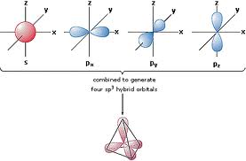
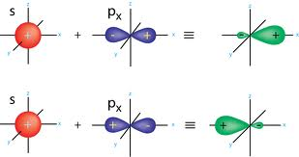
Hybridization of Atomic Orbitals
Hybrid Atomic Orbital
s atomic orbital
p atomic orbital

Slide 2
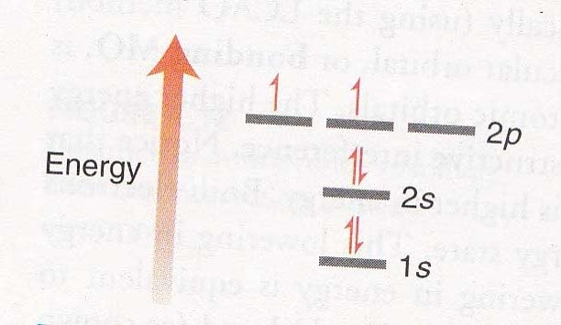
Fig. Electronic configuration of carbon
Electronic configuration of carbon shows that carbon atom has two
unpaired electrons and so we would expect carbon to form two bonds
But we know carbon forms four bonds!
How does a carbon atom form four bonds with only two unpaired
electrons?

Slide 3
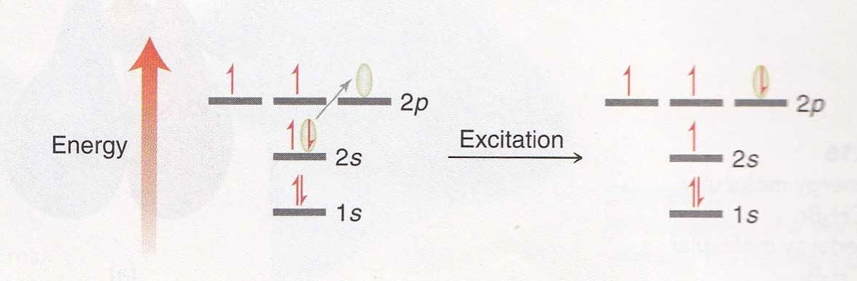
We can solve this problem by imagining an excited state of carbon:
a state in which a 2s electron has been promoted to a higher energy 2p
orbital
Now the carbon atom has four atomic orbitals capable of forming four
bonds
Fig. Electronic excitation of an electron in a carbon atom
But there is yet another problem here
The geometry of the 2s and three 2p orbitals does not satisfactorily
explain the observed three-dimensional geometry of methane

Slide 4
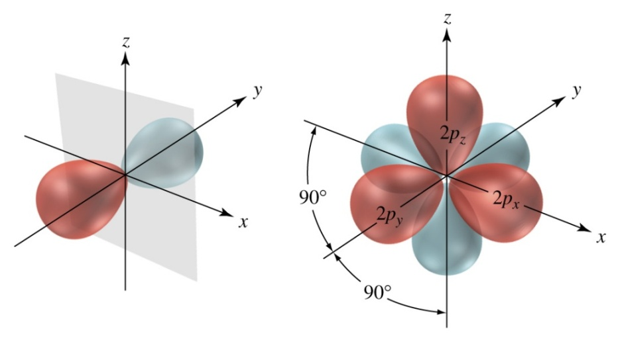
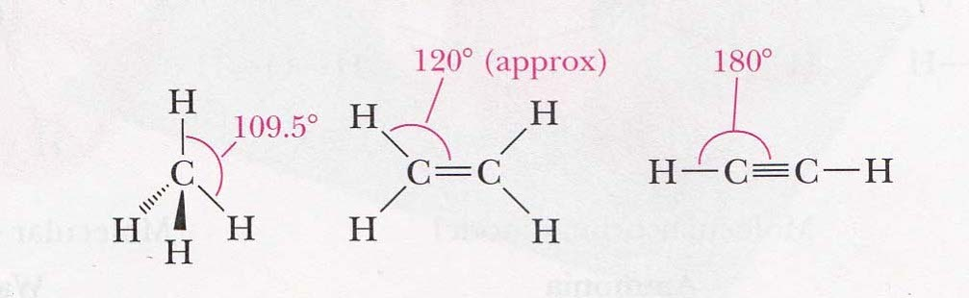
The three 2p atomic orbitals are at angles of 90° to one another, and if
carbon atom uses these orbitals to form covalent bonds, the bond angles
around each other would be 90° .
Fig. The three 2p orbitals are mutually perpendicular
one lobe of each orbital is shown in red, the other is blue
90° bond angles are rarely observed in organic molecules
Bond angle of 109.5° is found in molecules with single bond,
120° in molecules with double bond, and 180° in molecules
with triple bond.
How to solve this problem?

Slide 5
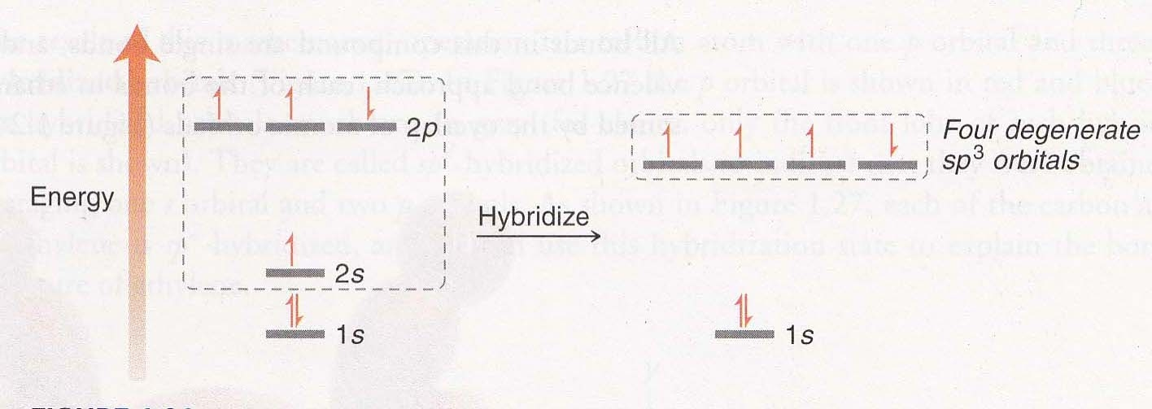
This problem was solved in 1931 by Pauling
He proposed that when a carbon atom forms bonds and is part of a
molecular structure, it can ‘mix’ the s and p atomic orbitals to form new
degenerate hybrid atomic orbitals
The number of hybrid orbitals formed is equal to the number of atomic
orbitals combined
Fig. An energy diagram showing four degenerate hybridized atomic
orbitals

Slide 6
There are three ways in which this mixing process can take place:
The 2s orbital is mixed with all three 2p orbitals . This is known as
sp³ hybridization
The 2s orbital is mixed with two of the 2p orbitals. This is known as
sp² hybridization
The 2s orbital is mixed with one of the 2p orbitals. This is known as
sp hybridization
Overlap of hybrid atomic orbitals can form two types of bonds, depending on the geometry of the overlap:
  σ bonds are formed by “direct” overlap.
  π bonds are formed by “parallel” overlap.

Slide 7
sp³ hybridization
In sp³ hybridization, the 2s orbital is mixed with all three of the
2p orbitals to give a set of four hybrid orbitals.
The four sp³ hybrid orbitals will each have the same energy
(degenerate) but will be different in energy from the original atomic
orbitals
The energy of each hybrid orbital is greater than the original
s orbital but less than the original p orbitals
Fig. sp³ hybridization

Slide 8
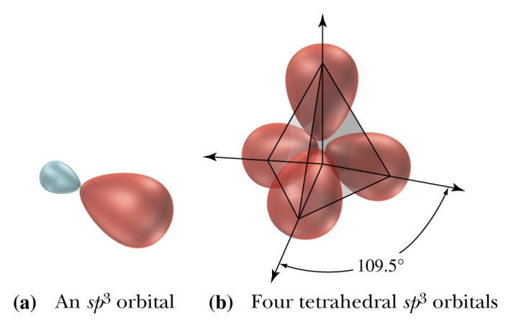
As the four sp³ hybridized orbitals are equivalent in energy, they
will therefore position themselves as far apart from each other as
possible, achieving a tetrahedral geometry
Geometry of sp³ hybridized orbitals:
Hybridized atomic orbitals are unsymmetrical -a deformed looking dumbbell
This deformed dumbbell looks more like a p orbital than an s orbital since
more p orbitals are involved in the mixing process
The hybridized atomic orbitals have a larger front lobe (also called major lobe,
shown in red) and a smaller back lobe (also called minor lobe, shown in blue)
The larger front lobe enables hybridized atomic orbitals to be more efficient
than p orbitals in their ability to form bonds

Slide 9
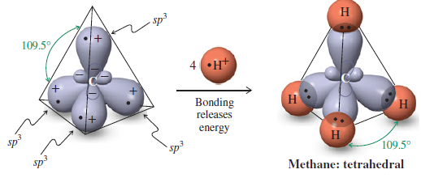
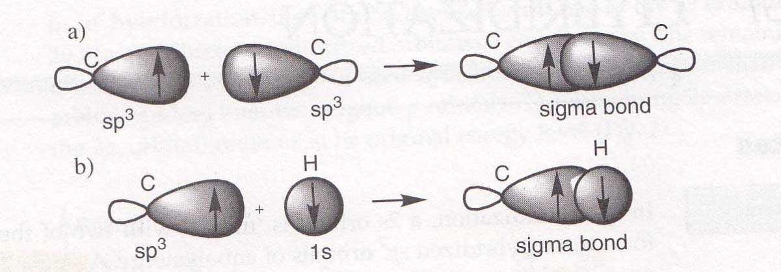
Carbon atom has four valence electrons, and one electron is
placed in each sp³ hybrid orbital
Each partially filled sp³ hybrid orbital then overlaps with a partially
filled 1s atomic orbital of hydrogen to form a sigma (σ) bond, and
hydrogen atoms occupy the corners of a regular tetrahedron
Fig. a) σ bond between two sp³ hybridized carbons; b) σ bond between an
sp³ hybridized carbon and 1s atomic orbital of hydrogen

Slide 10
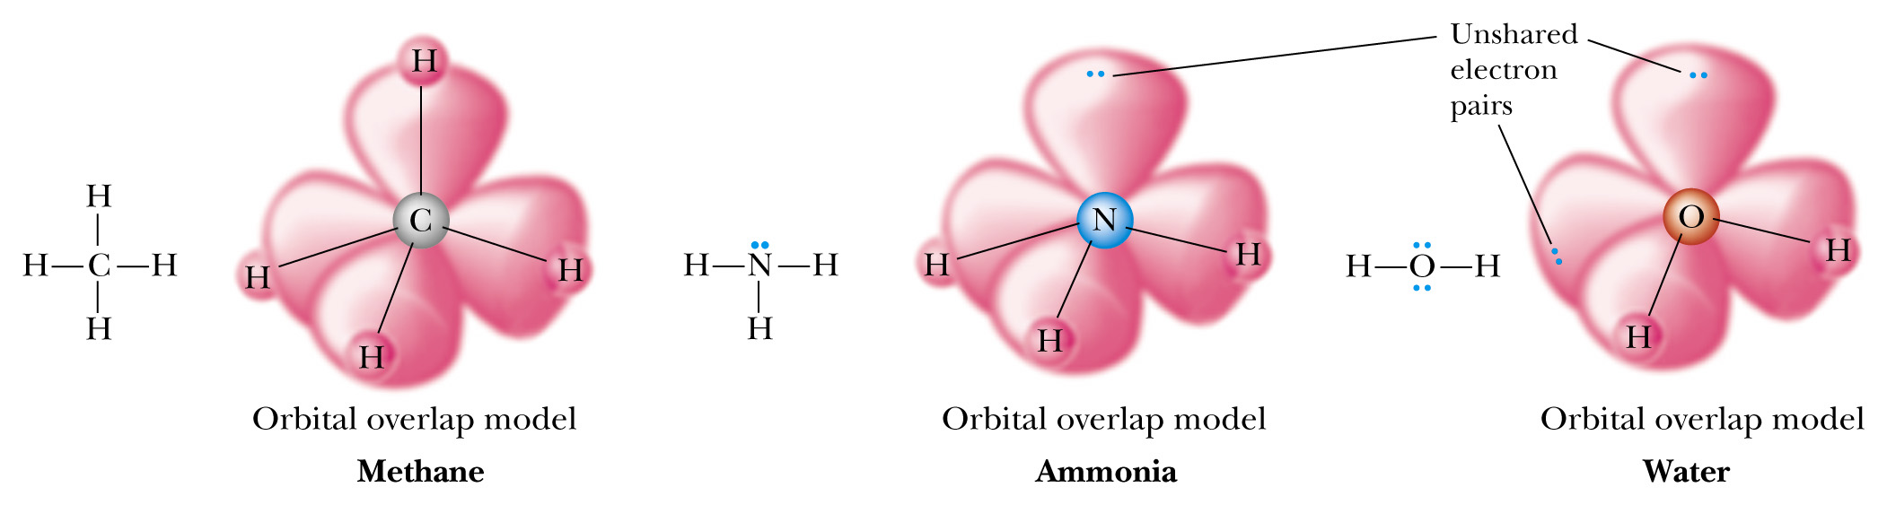
Molecular orbital picture of methane, ammonia, and water.

Slide 11
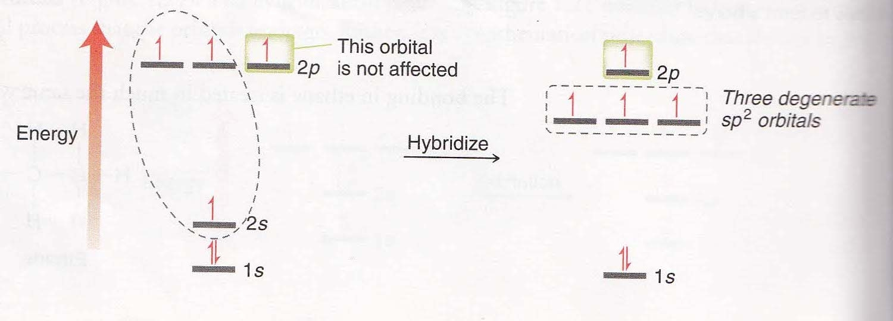
sp² hybridization
In sp² hybridization, a 2s orbital is mixed with two of the 2p
orbitals to form three hybridized sp² orbitals of equal energy
A single 2p orbital is left over which has a slightly higher energy
than the hybridized orbitals
Fig. An energy diagram showing three degenerate sp²- hybridized
atomic orbitals

Slide 12
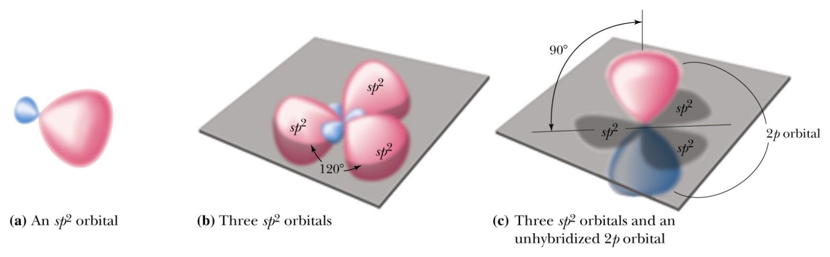
Geometry of sp² hybridized orbital
Each sp² hybrid orbital consists of two lobes, one larger than the
other
The three sp² hybrid orbitals lie in a plane and are directed
toward the corners of an equilateral triangle
The angle between sp² hybrid orbitals is 120°
The third 2p atomic orbital is not involved in hybridization and
consists of two lobes lying perpendicular to the plane of the sp²
hybrid orbitals

Slide 13
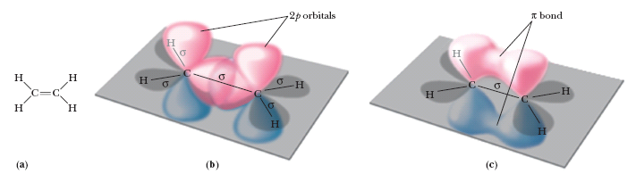
Covalent bond formation in ethylene
Each sp² hybridized carbon forms three σ bonds using three
sp² hybridized orbitals
The remaining 2p orbital overlaps ‘side on’ with a neighboring
2p orbital to form a pi (π) bond
A pi (π) bond is a covalent bond formed by the overlap of
parallel p orbitals
pi (π) bond is weaker than the σ bonds
Ethylene is a planar molecule

Slide 14
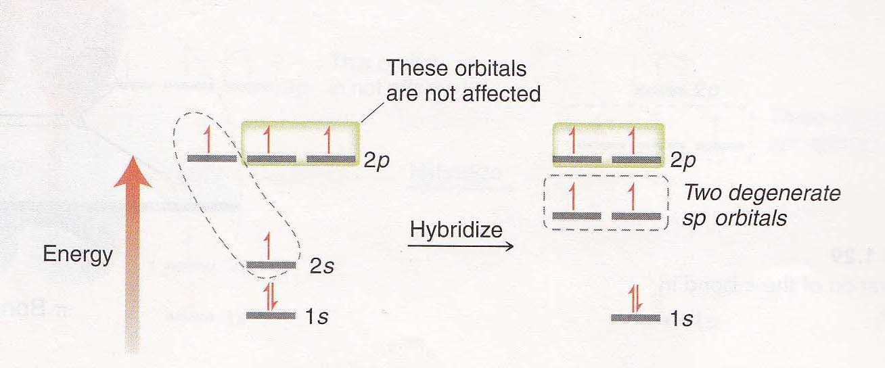
sp hybridization
In sp hybridization, the 2s orbital and one of the three 2p orbitals
are mixed to form two hybridized sp orbitals of equal energy
Two 2p orbitals are left over and have slightly higher energy than
the unhybridized orbitals
Fig. An energy diagram showing two degenerate sp-hybridized
atomic orbitals

Slide 15
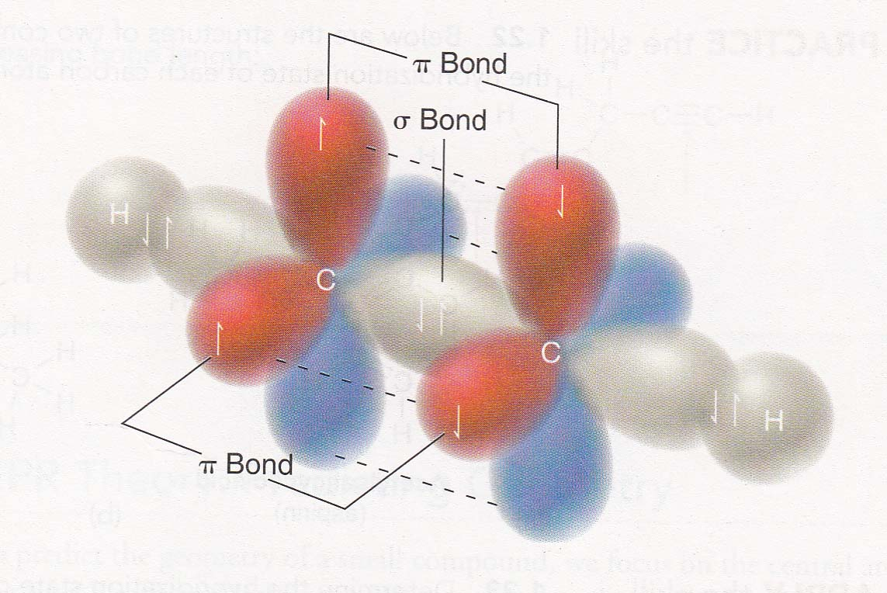
The two sp hybrid orbitals lie at an angle of 180°
The axes of the unhybridized 2p atomic orbitals are perpendicular
to each other and to the axis of the two sp hybrid orbitals
Fig. σ and π bonds in acetylene

Slide 16
Bonding in acetylene
Acetylene consists of one sigma bond and two pi bonds
Each sp hybridized carbon of an acetylene can form two σ bonds
using sp hybridized orbitals
The remaining two 2p unhybridized atomic orbitals can overlap
‘side-on’ to form two π bonds
Acetylene is a linear molecule

Slide 17
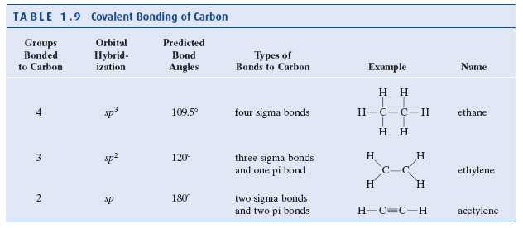
Covalent bonding of carbon

Slide 18
Functional groups
A functional group is a group of atoms within a large molecule
that has a characteristic chemical behaviors
Functional groups are important because they are the units by
which we divide organic compounds into families of compounds
Functional groups serve as the basis for naming organic
compounds
Functional groups are the sites of chemical reaction
Functional groups determine the physical properties of a
compound

Slide 19
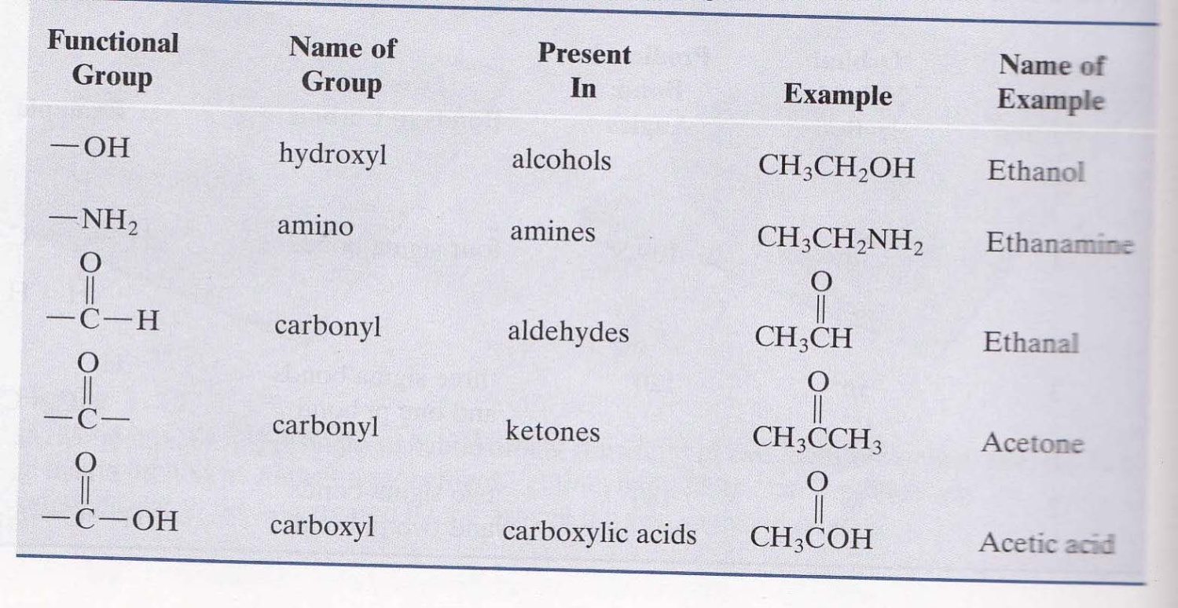
Some common functional groups

Slide 20
